Slide 1

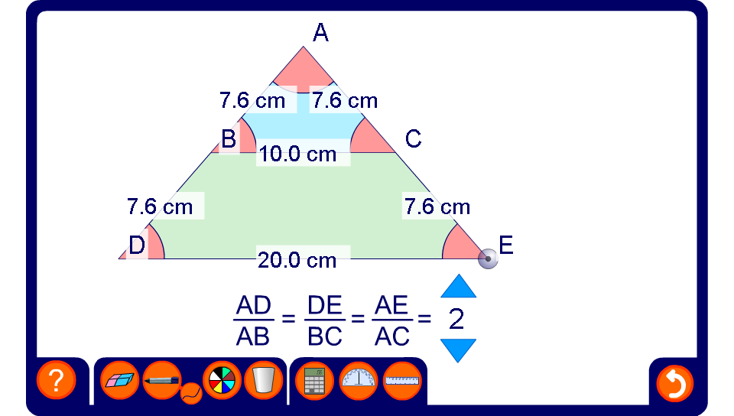


Similar triangles 1
Notes:
Discuss why, if BC and DE are parallel, the interior angels of triangle ABC and triangle ADE are the same. Conclude that triangles ABC and ADE are similar.
Drag points D and E to modify the angles and lengths. BC and DE will remain parallel. Show that the ratio of the side lengths remains constant.
Hide some of the side lengths and modify the shape. Ask pupils to calculate the missing side lengths.
Change the ratio between the two similar triangles and repeat the activity.

Slide 2
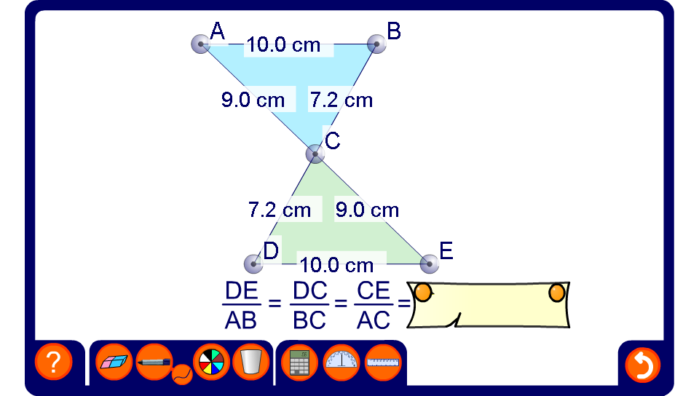
Similar triangles 2
Notes:
Discuss why, if AB and DE are parallel, the interior angels of triangle ABC and triangle CDE are the same. Conclude that triangles ABC and CDE are similar.
Drag points A, B, D and E to modify the angles and lengths. AB and DE will remain parallel. Calculate the ratio of the corresponding side lengths to find the scale factor for the enlargement.
Hide some of the side lengths and modify the shape. Ask pupils to calculate the missing side lengths.

